Slide 1
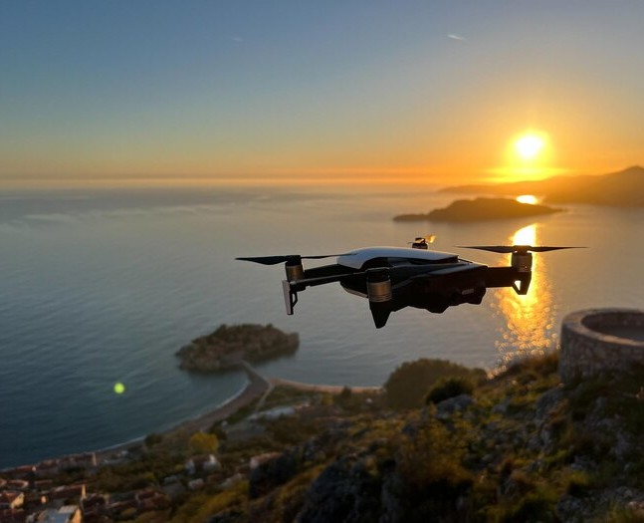
REVOLUTIONIZING AERIAL INTELLIGENCE: THE POWER AND POTENTIAL OF AI-BASED DRONE APPLICATIONS

Slide 2
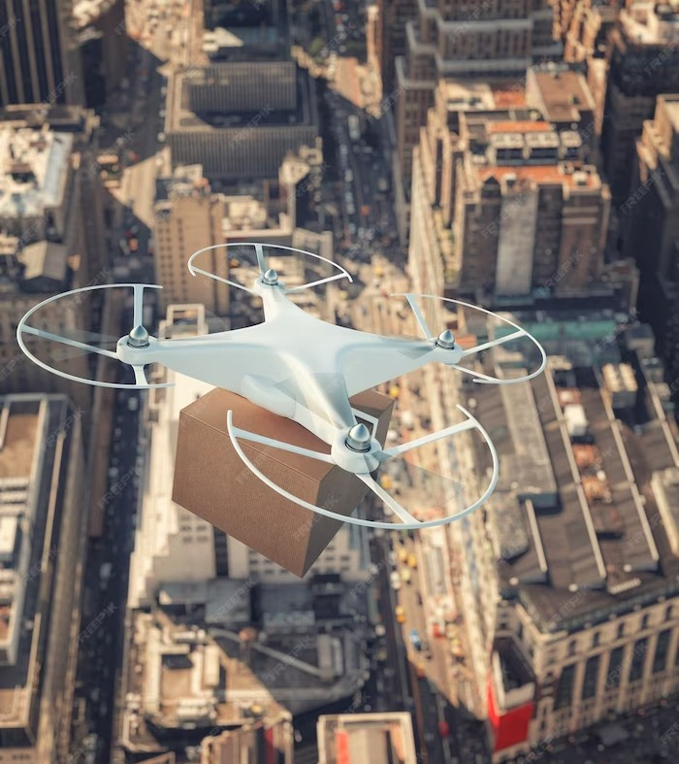
REVOLUTIONIZING AERIAL INTELLIGENCE
Artifical intelligence(AI) is transforming the drone industry. New AI-based drone applications are being developed to enhance aerial intelligence, making drones more eficient and effective.

Slide 3
THE POWER OF AI-BASED DRONE APPLICATIONS
AI-based drone applications have the potential to revolutionize industries such as agriculture, construction, and security. By leveraging AI, drones can collect and analyze data faster and more accurately than ever before, leading to increased eficiency and productivity.

Slide 4
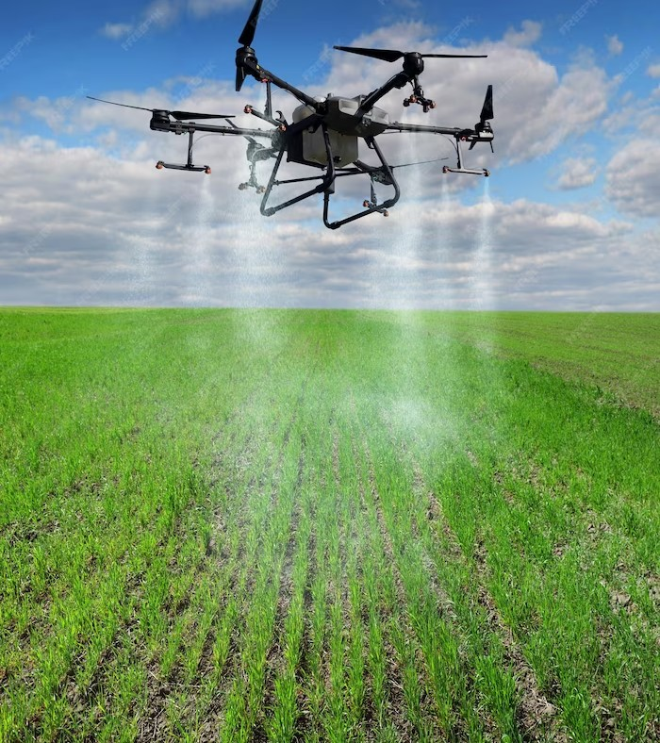
AGRICULTURE
AI-based drone applications are being used in agriculture to monitor crop health, analyze soil quality, and optimize crop yields.
Drones equipped with AI can quickly and accurately identify areas of a ﬁeld that require attention, allowing farmers to take action before crop yields are affected.

Slide 5
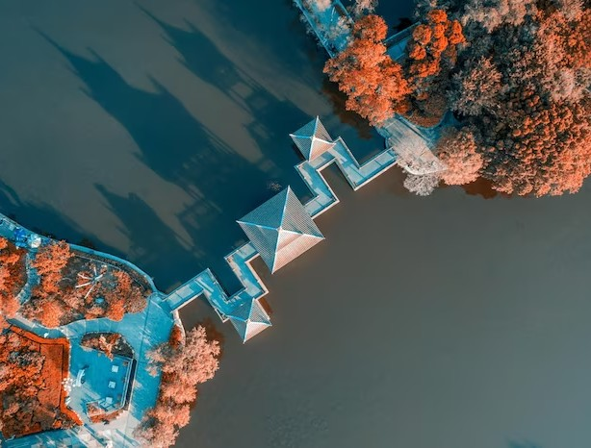
CONSTRUCTION
AI-based drone applications are being used in construction to monitor job sites, inspect structures, and improve safety. Drones equipped with AI can quickly and safely inspect hard-to-reach areas, reducing the need for human workers to perform dangerous tasks.

Slide 6
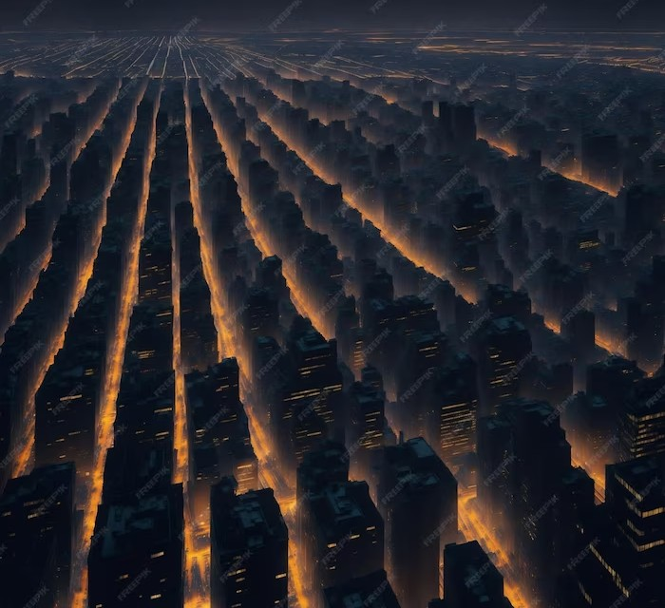
SECURITY
AI-based drone applications are being used in security to monitor large areas, detect threats, and gather intelligence. Drones equipped with AI can quickly identify potential security risks, allowing security personnel to take action before an incident occurs.

Slide 7
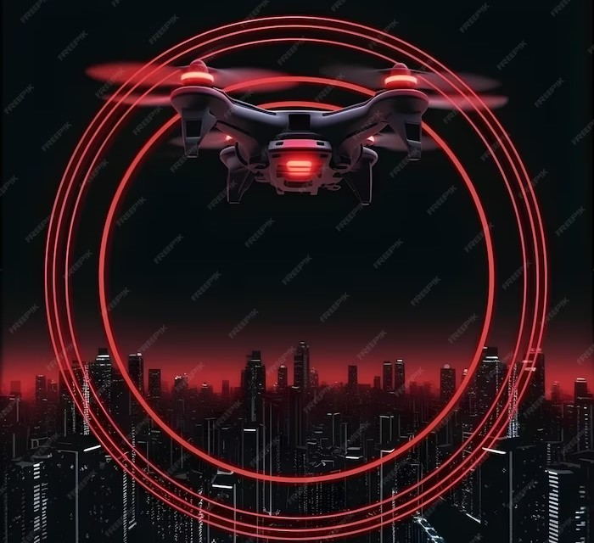
CHALLENGES
Despite the many beneﬁts of AI-based drone applications, there are still challenges that need to be addressed. These include privacy concerns, regulatory issues, and technical limitations.

Slide 8

PRIVACY CONCERNS
AI-based drone applications can collect large amounts of data, raising concerns about privacy. It is important for companies to be transparent about what data is being collected and how it will be used, and to ensure that proper security measures are in place to protect sensitive information.

Slide 9
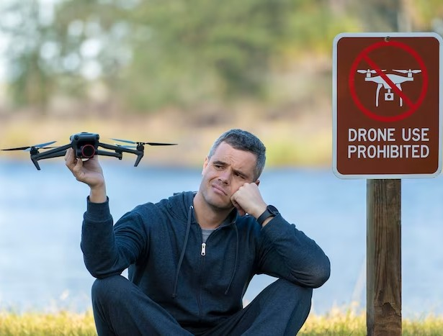
REGULATORY ISSUES
The use of drones is subject to regulatory restrictions in many countries. Companies developing AI-based drone applications must ensure that their products comply with all relevant regulations and obtain any necessary permits before deploying their drones.

Slide 10
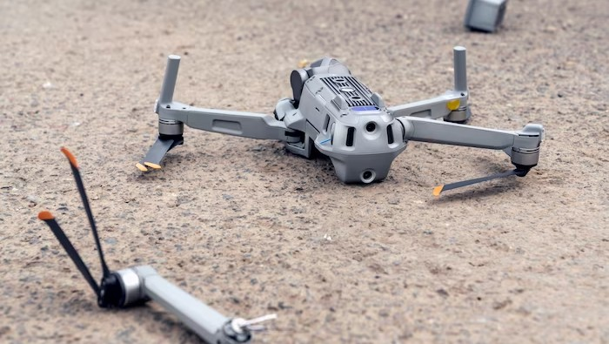
TECHNICAL LIMITATIONS
AI-based drone applications are still subject to technical limitations. For example, drones may have limited battery life or be unable to operate in certain weather conditions. Companies developing AI-based drone applications must be aware of these limitations and work to overcome them.

Slide 11
CONCLUSION
AI-based drone applications have the potential to revolutionize industries and enhance aerial intelligence. However, companies must address challenges such as privacy concerns, regulatory issues, and technical limitations to fully realize the beneﬁts of this technology.

Slide 12
Thanks!
Do you have any questions?
Harshaa77@gmail.com
By- Harsha and team

